Slide 1
UML
Use-Case Relationships and Scenarios
By PJ Davies
With Reference to:
  Real-Time UML: by BP Douglass.
  ISBN 0-201-65784-8
Use-Case Diagram Tutorial based on Visual Paradigm (tool we will use): https://www.youtube.com/watch?v=tLJXJLfLCCM&list=PL05DE2D2EDDEA8D68
©Paul Davies 2020. Not to be copied, used, or revised without explicit written permission from the copyright owner. This lecture may contain animations and is best viewed as a slide show

Slide 2
Developing Use-Cases Capturing Scenarios
When we talk about use-cases, we always end up discussing “scenarios”.
In essence, a scenario is a specific instance of a use case that is played out between actor and system at run time. What does this mean?
Well take for example the ATM Withdraw Cash use-case. Ask yourself what could happen when a particular customer comes to make a cash withdrawal.
Ideally, we would like the user to enter the correct PIN and have sufficient money in their account to make the requested withdrawal.
This is certainly one particular scenario that could be played out between user and system and is probably the primary or most commonly acted out scenario for this use case. Certainly it is the one the bank had in mind when it decided to offer the cash withdrawal functionality inside their ATM.

Slide 3
However, it is easy to envisage a number of different scenarios which don’t lead to the same end result for the customer, e.g.
  What if the users PIN is incorrectly entered?
  What if the user has insufficient funds in their account?
  What if the ATM cannot read the cards magnetic strip?
  What if the ATM is out of money?
  What if the bank central computer is off-line?
These are different use-case scenarios since the interaction between user and system will be different and the outcomes are not the same as someone who interacts and successfully obtains money.
Put simply, you will probably have a scenario for every ‘what-if’ type question that can be uncovered/discussed during analysis.
It’s important to realise that these ATM scenarios are NOT Errors since they may well reflect important business logic and rules of operation for the bank and thus the system designer must handle these in the finished product, not throw some kind of “hissy fit/divide by zero type exception” when they happen.

Slide 4
Put another way, a use-case binds together and describes a set of scenarios any one of which could be played out in real time when a user interacts with the system.
Documenting Scenarios in a Use Case
There are many different ways to document scenarios in a use-case.
The important thing, obviously, is to capture all those ‘what-happens-if’ type situations.
Don’t however get “hung up” trying to evolve a clever formal procedure for documenting them. Just choose the method that best captures or describes the type of scenario you are faced with documenting.
Remember, the customer paying for the software also has to be able to read/understand any use-case description and scenarios.

Slide 5
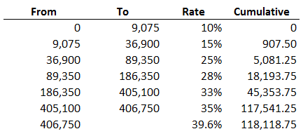
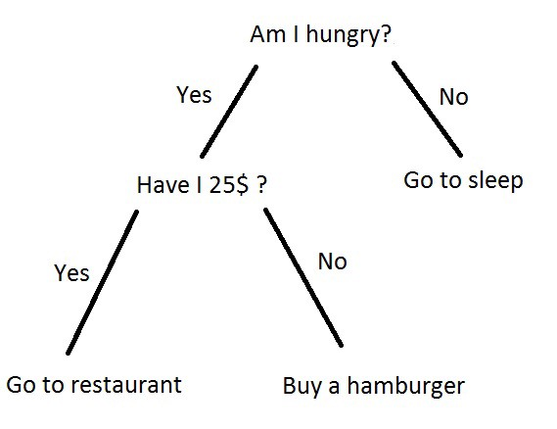
Use one or more of the following to document use cases and scenarios. If it’s clear to you, the customer and the developer, it’s good enough.
  Simple Text Descriptions written in English (see library and ATM example)
  Flowcharts
  Structured pseudo-code and algorithms (e.g. ‘C’ like using if-else, do-while) e.g. if (day == Friday) then leave work at 2:30pm
  Formulas (e.g. area = PI * r²)
  Look up tables: A mapping of inputs to outputs (e.g. income tax bands)
  Decision Trees

Slide 6
Documenting Simple Scenarios in the Use-Case Request Cash using text/pseudo code
Start of Primary scenario/transaction
  The user inserts their ID card into the system.
  The system identifies the user from the card.
  If the system cannot read the card then <<Scenario 1>>
  The system contacts the banks central computer to request the PIN number for the card and their account details.
  If bank central computer cannot access user’s account then <<Scenario 2>>
  The system prompts the user for their PIN.
  The user enters their PIN.
  If PIN cannot be authenticated <<Scenario 3>>
  The user is prompted for the amount of the withdrawal.
  The user enters the amount of withdrawal.
  The system checks with the banks central computer
  If the user has insufficient funds <<Scenario 4>>
  The cash is dispensed and the customer’s account at the Bank Central Computer is debited with the withdrawal amount.
  The card is returned to the user and a receipt issued.
End-Of-Transaction
Scenario 1: The user’s card is returned. End of Transaction
Scenario 2: The user’s card is returned. End of Transaction
Scenario 3: The user is given two more attempts to enter a correct PIN.
If this fails the card is kept and the transaction ends.
Otherwise resume primary scenario.
Scenario 4: The user is given the opportunity to enter a lesser amount or cancel transaction. If cancel is chosen, the card is returned and the transaction ends. If the lesser amount is acceptable then resume primary scenario.

Slide 7
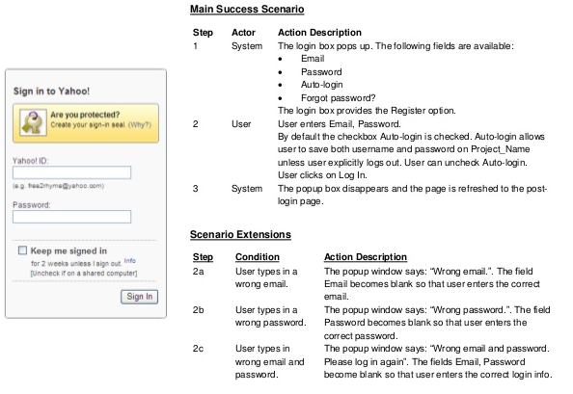
Another Example – Documenting Scenarios in a Log-in Use-Case for Yahoo
There’s no right/wrong way to document. If the reader understands it, it’s good enough

Slide 8
Use Case Relationships
How to identify them and
How to capture them

Slide 9
The Includes Relationship: Used to Model Common User Interactions
When designing use-cases it is often apparent that there exists some commonality or replication between parts of one or more use cases. For example take the ATM.
In each one of the four use cases below
  Withdraw Cash
  Request Balance
  Request Statement
  Request Cheque Book
the user is required to insert their card and enter their PIN, which is then verified by the bank central computer.
Rather than duplicate the same common user interaction/outcome within each of the above four use-case descriptions, we might extract it and choose to represent it with a mini use-case called ‘identify user’ whose functionality is included as part of the other four use-cases.
Such an ‘includes’ relationship is shown in the simplified diagram over the page. The dashed line indicates a dependency relationship i.e. one use-case depending upon another. The arrow points to the use-case that will be included, thus

Slide 10
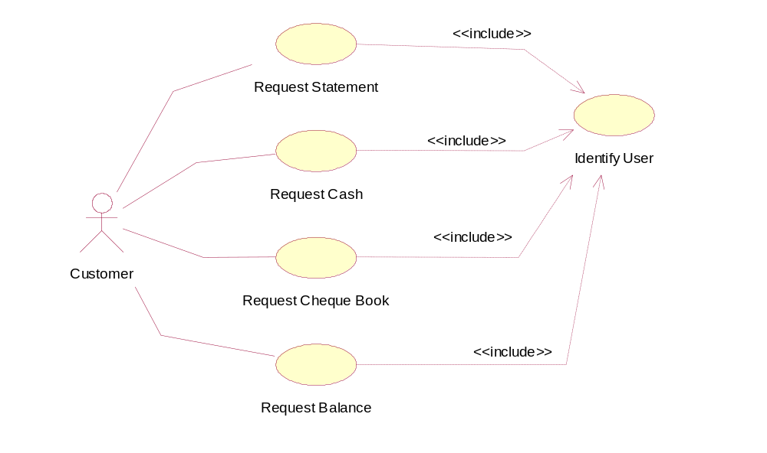
ATM
Withdraw Cash
Exercise: See if you could document this new mini use-case.
What changes would you make to the documentation of the other use cases to show the inclusion?
VERY Important Note:
Don’t fall into the trap of treating use-cases like functions in a program where you continually try to break them down into smaller entities.
Use-cases, (even mini ones like ‘Identify-User’), should always involve some high level documentable interaction between a user and the system and be able to describe the measurable benefit to the user and effect on system, otherwise they simply aren’t use-cases – they are just steps within a use-case.
Although not always a definitive question, ask yourself if the customer would be happy to pay for a release of the software with the addition of your new use case. If not then it’s probably not very interesting to them because it’s an implementation detail or functionality that is just part of a bigger use-case and not a use-case in its own right.

Slide 11
Example Incorrect use of Use cases
‘Verify User with main computer’ and “Get Balance of Account” below both contain functionality important to the success of the system, but neither should be shown as mini-use cases because
    There is no customer interaction involved in either use-case.
    There is no direct, immediate, measurable benefit to the customer from that use-case alone.
    Because the customer is not aware of the execution or outcome of the use-case, then it simply isn’t a use-case because there IS NO USER.
ATM
<<include>>
Verify User with
Main Computer
NOT really Use-cases
<<include>>
Customer
<<include>>
Get Balance
of Account

Slide 12
Documenting simple ‘Includes’ relationships in a Use-Case: Withdraw Cash
Start of Primary scenario/transaction
  Include Identify User (a prerequisite or precondition for the execution of this use-case)
  If identification fails << Scenario 1>>
  The system contacts the banks central computer to request the PIN number for the card and their account details.
  If bank central computer cannot access users account <<Scenario 2>>
  If PIN cannot be authenticated <<Scenario 3>>
  The user is prompted for the amount of the withdrawal.
  The user enters the amount of withdrawal.
  The system checks the account balance with the banks central computer
  If the user has insufficient funds <<Scenario 4>>
  The cash is dispensed and the customer’s account at the Bank Central Computer is debited with the withdrawal amount.
  The card is returned to the user and a receipt issued.
End-Of-Transaction
Scenario 1: The users card is returned. End of Transaction
Scenario 2: The users card is returned. End of Transaction
Scenario 3: The user is given two more attempts to enter a correct PIN.
If this fails the card is kept and the transaction ends.
Otherwise resume primary scenario.
Scenario 4: The user is given the opportunity to enter a lesser amount or cancel the transaction. If cancel is chosen, the card is returned and the transaction ends. If the lesser amount is acceptable then resume primary scenario.
Show where the includes occurs in interaction

Slide 13
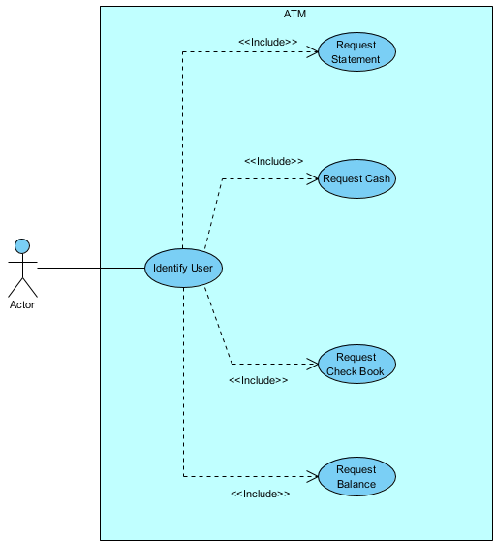
What’s wrong with this use-case diagram ?
It’s back to front, it’s how the software might be implemented as one function (Identify User) calling the other functions. Each use case should connect to the user, not the calling functions – we're trying to do Use Case modelling here, not coding.

Slide 14
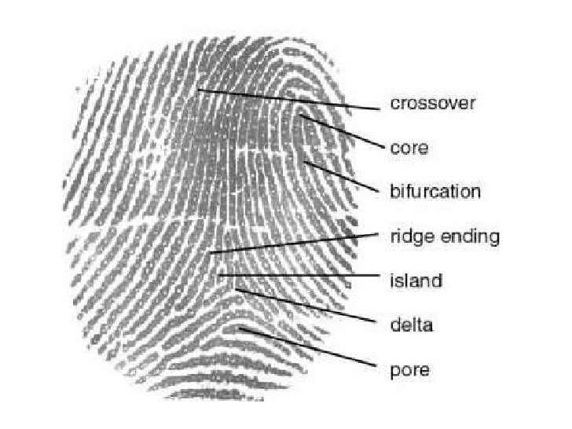
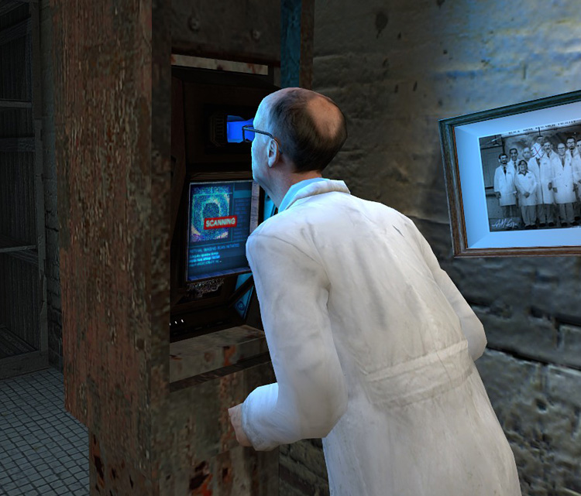
The Generalisation Relationship: Models different solutions to the same goal
Another useful relationship that can occur between use-cases is one of generalisation.
This occurs when two or more use-cases attempt to achieve the same goal or objective but achieve it via different means.
For example, suppose an ID card with a magnetic strip was not the only way that you could identify yourself to a ATM.
Let’s suppose that fingerprint and retina scan are also acceptable.

Slide 15
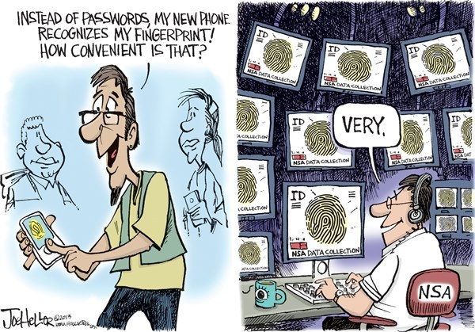
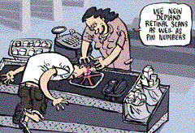
You could imagine that a user might be offered the choice of which method of identification to use when they arrive at the ATM.
Alternatively, a range of different ATM models might be produced with only one of these 3 means of identification built in, thus their interaction with the user would vary, but the outcome/benefits to the user would be the same, namely that the user’s identification is established.
It is therefore possible to describe three different use-cases bound together by the common objective of identifying the user.

Slide 16
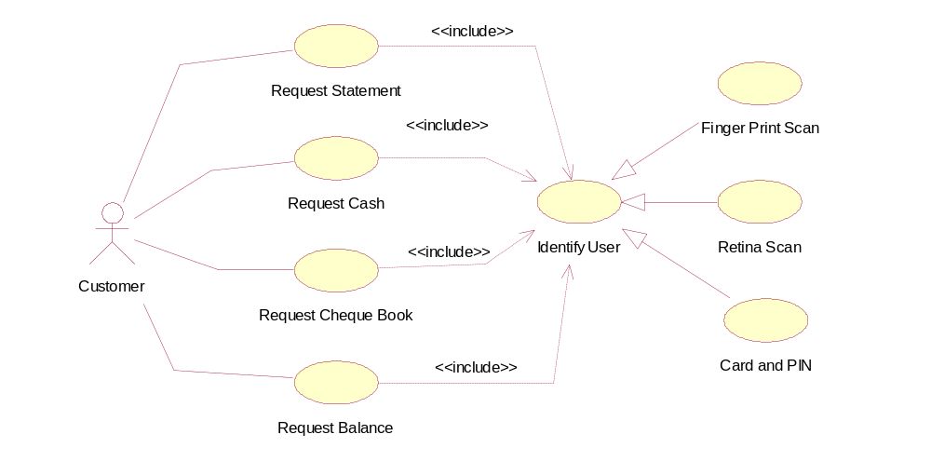
We could represent these three use-cases using a generalisation relationship, which is shown below. You can relate this to the previous use case diagrams.
Note arrow type and direction
Withdraw Cash
‘Finger Print Scan’, ‘Retina Scan’ and ‘Card and Pin’ are all ‘kinds of’ use case that identify the user
ATM

Slide 17
This diagram should be interpreted to mean that there are three possible methods
for identifying a user. Thus the four major use cases
  Withdraw Cash
  Request Balance
  Request Statement
  Request Cheque Book
will obviously include only one of these three means of identification. The choice may be one made by the user at run time, or imposed upon them by the model of ATM they are using.
When describing generalisation use cases the base or root use-case (i.e. Identify User) should be documented in very general terms, i.e. it should just list the objectives of the use-case. For instance the following should suffice.
“Identify the user”
obtain their account details from the bank central computer
The three specific or derived use-cases can be documented with specific details of how the identification is performed.

Slide 18
The Extends Relationship: Used to Model Optional Behaviour
The final use-case relationship is one that allows extensions to be made to a use-case.
This can be used to model optional behaviour, and is most common used to model complex scenarios within a use-case.
For example, in the ATM, the use-case ‘Withdraw Cash’ contained a number of different scenarios that could be acted out when a customer requests cash.
We could of course document these scenarios with carefully chosen textual descriptions placed within the use-case documentation itself as shown previously.
However, if the scenarios were particularly interesting (and they involved some user-interaction with a direct measurable benefit to the user and an effect on the system) then we could document them in their own mini-use cases and add an extends relationship to their parent or containing use-case (the one documenting the primary use-case)

Slide 19
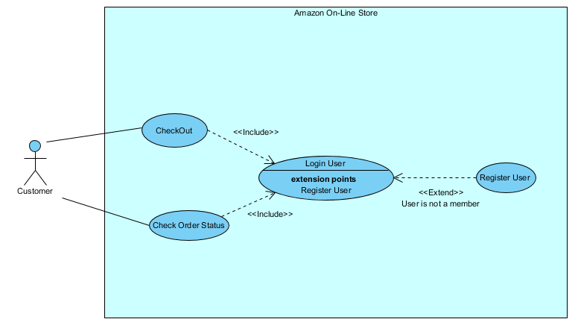
Example: In the diagram below, we see an example of an extends use-case being applied to an on-line Amazon store. Here, “Register User” extends “Login User” since the Register User might not happen, in particular, it would only happen if the user is unknown to the system.
If the mini use-case always gets executed when the parent use-case runs, then the mini use-case should be modelled with an ‘includes’ relationship, if it’s optional, user behaviour that may not always happen, model with extends.
Note arrow type and direction

Slide 20
Documenting a Use-Case with simple Extends
Amazon Use-Case: Login User
  . . .
  Ask user for Name and Email or Click Button for new user
  If( user clicks button)
  Extend use case : Register User
  . . .
End-Of-Transaction
Notice how an extended use case is invoke just by referring to its name, this isn’t a precise syntax, but its understandable and thus works as well as any other approach.
Thus in step 5 above, the extended use-case “Print Receipt” is invoked if the user asks for a receipt.
It’s important not to get hung up on a specific syntax and notation for describing use-cases, they are not precise programming statements, they capture requirements in an written manner that both analyst and customer can understand.
We model them more precisely using sequence diagrams.
At this point, the use-case branches to another user case to register the new user

